Slide 1
Sensor Cahaya Raspberry Pi
Eko Puji Pramono (05111540000065)
Reinhart Caesar (05111540000132)

Slide 2
Alat dan Bahan
1x Perangkat Raspberry Pi
5x Kabel Jumper Male to Female
1x Breadboard
1x Sensor Cahaya LDR
1x Kapasitor 1μF
1x Lampu LED
1x Resistor 330 Ω

Slide 3
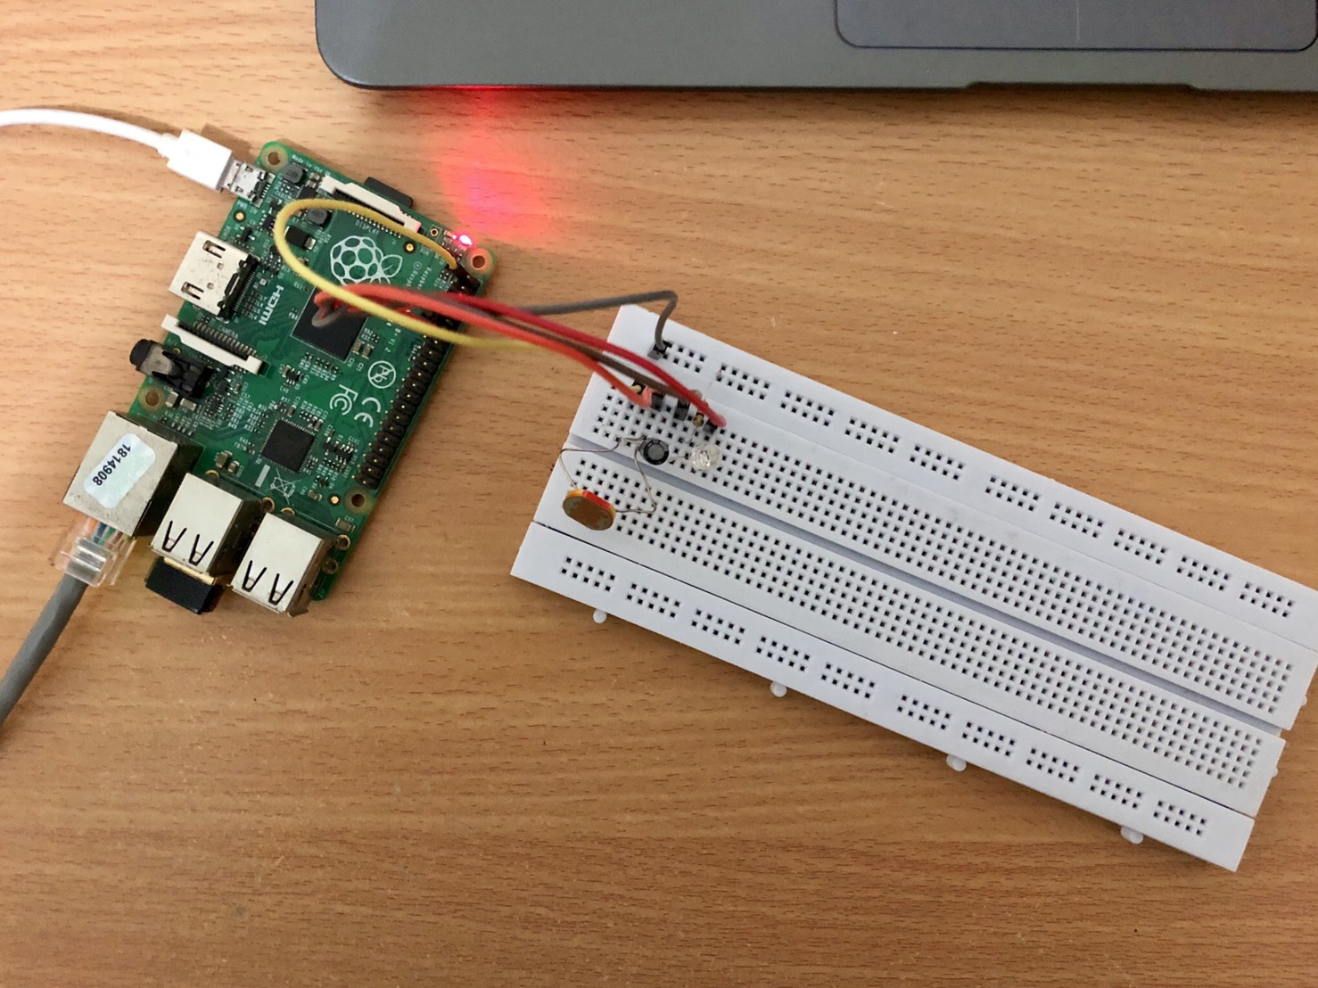
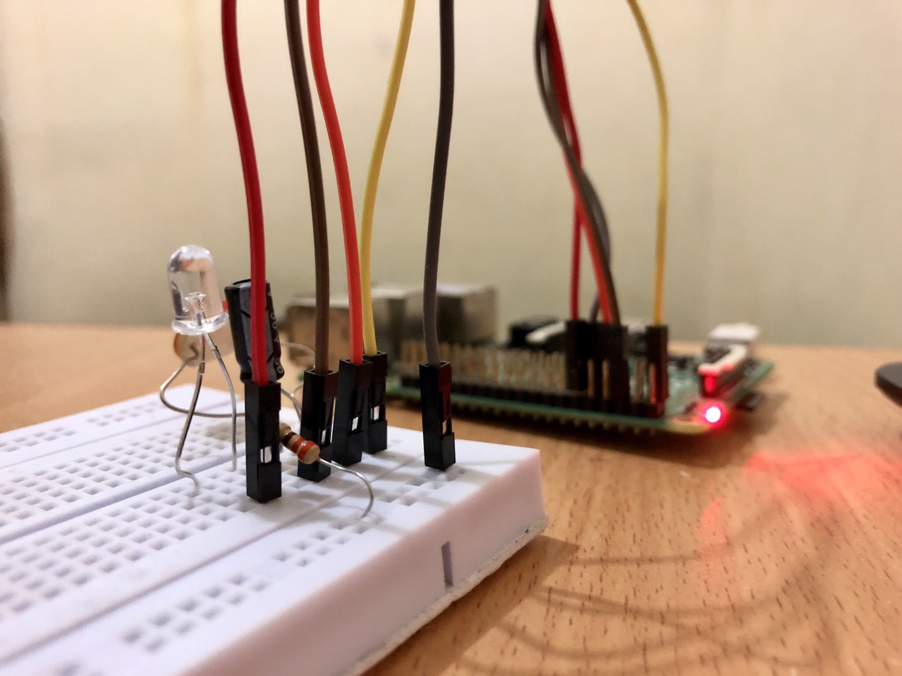
Perangkat

Slide 4
Code
Code terdiri dari:
lampuiot.php (code halaman GUI)
LED_ON.py (script menyalakan lampu)
LED_OFF.py (script mematikan lampu)
LED_AUTO_LDR.py (script penyalaan lampu otomatis menggunakan sensor cahaya LDR)
Code dapat dilihat di: https://github.com/ekoew/IoT-Raspi-LDRLED

Slide 5
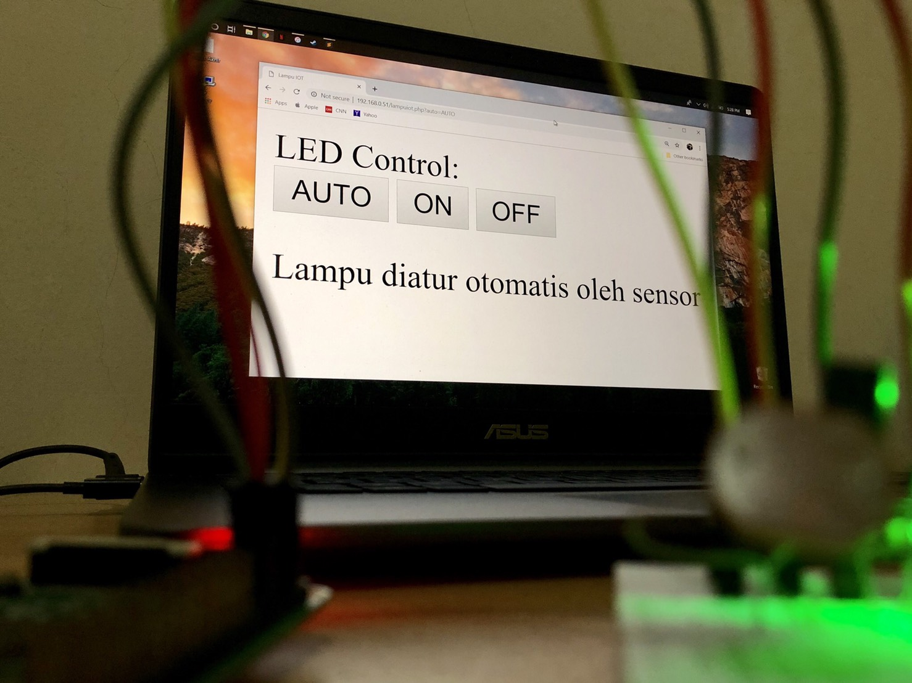
User Interface

Slide 6
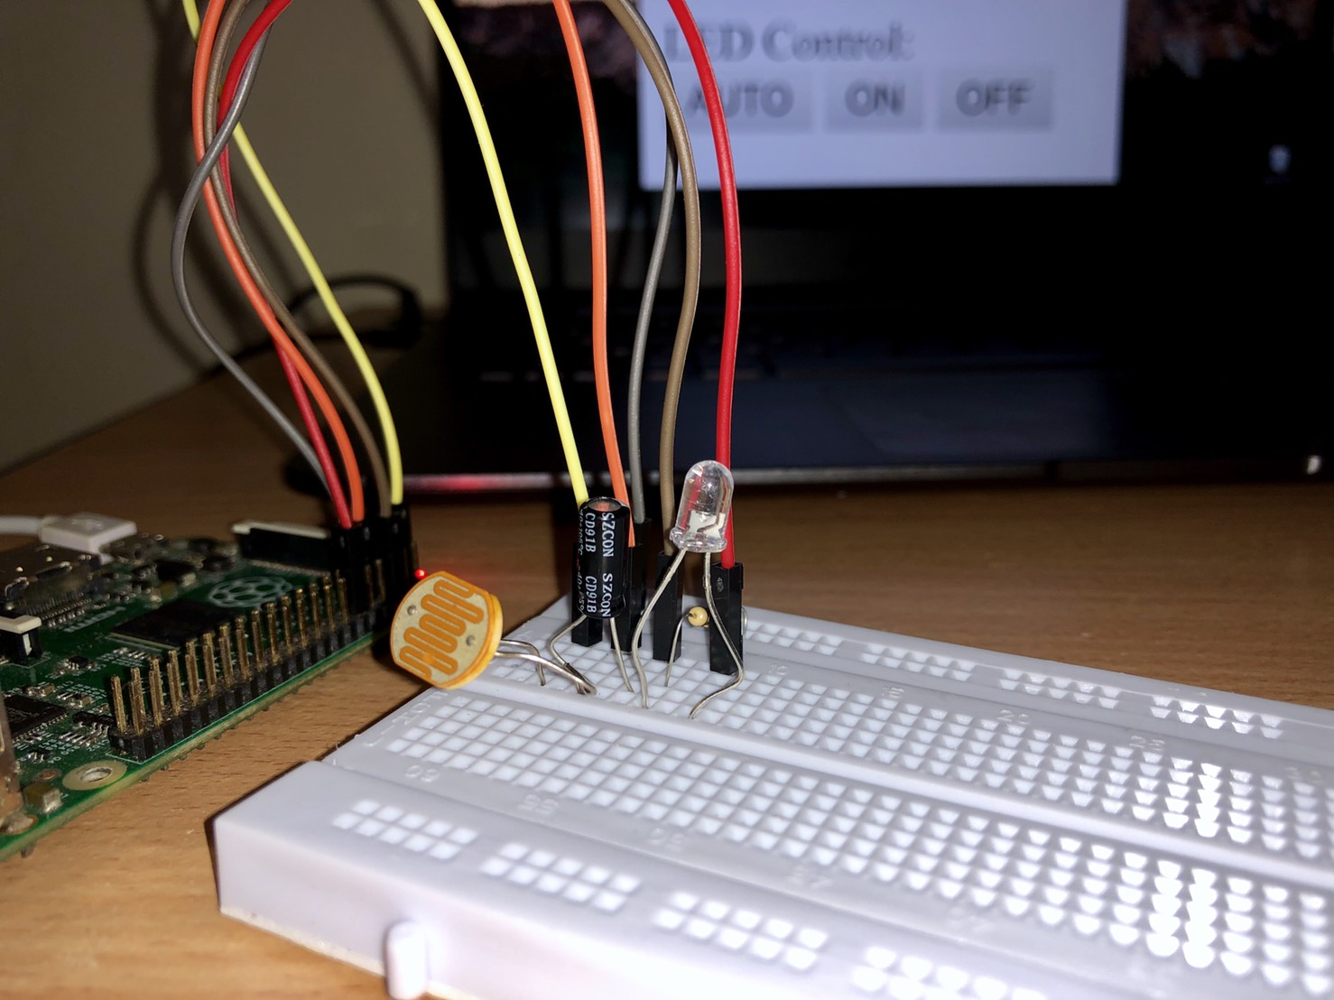
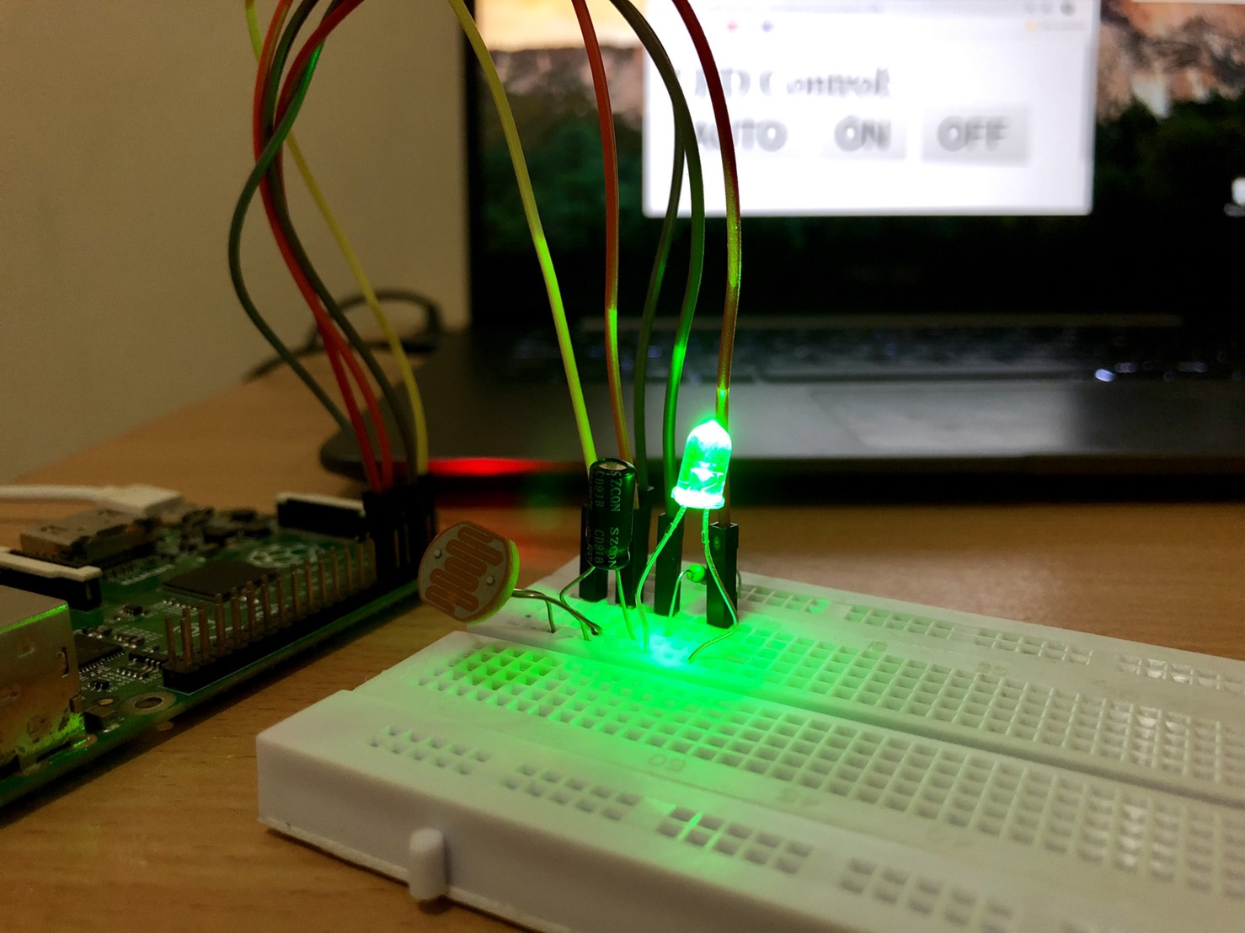
Output
Ada Lampu (Flash Kamera)
Tidak Ada Lampu

Slide 7
Sumber
https://projects.raspberrypi.org/en/projects/physical-computing/12
https://thepihut.com/blogs/raspberry-pi-tutorials/27968772-turning-on-an-led-with-your-raspberry-pis-gpio-pins
http://www.raspberry-pi-geek.com/Archive/2014/07/PHP-on-Raspberry-Pi

